Slide 1

House Price Prediction Using Machine Learning
Submitted by:
Gitik Kaushik C0867079
Ankit Goswami C0863649
Yajur Sethi C0863424
Harcharan Singh C0863764

Slide 2
Abstract
Accurate forecasting of house prices is crucial in the real estate landscape, impacting stakeholders such as homebuyers, sellers, and investors.
This research utilizes machine learning methodologies to construct a robust model for predicting house prices.
Popular algorithms including linear regression, decision trees, Random Forest, and Gradient Boosting are applied, contributing to a deeper understanding of housing market dynamics.

Slide 3
Objective
Central Goal: Create a robust machine learning model for accurate house price prediction.
Specific Objectives:
Data Preparation and Feature Engineering
Model Development
Training and Testing
Variable Impact Analysis
Comparison of Algorithms
Contribution to Real Estate Decision-Making

Slide 4
Methodology
Steps Involved:
Dataset Selection
Data Cleaning
Data Exploration
Feature Engineering
Model Selection
Hyperparameter Tuning

Slide 5
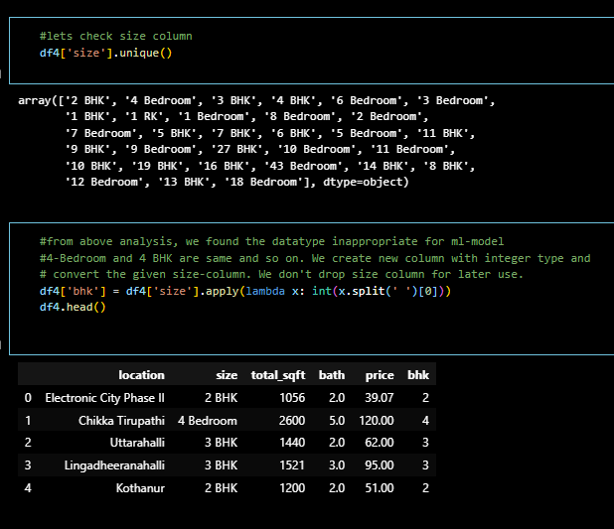
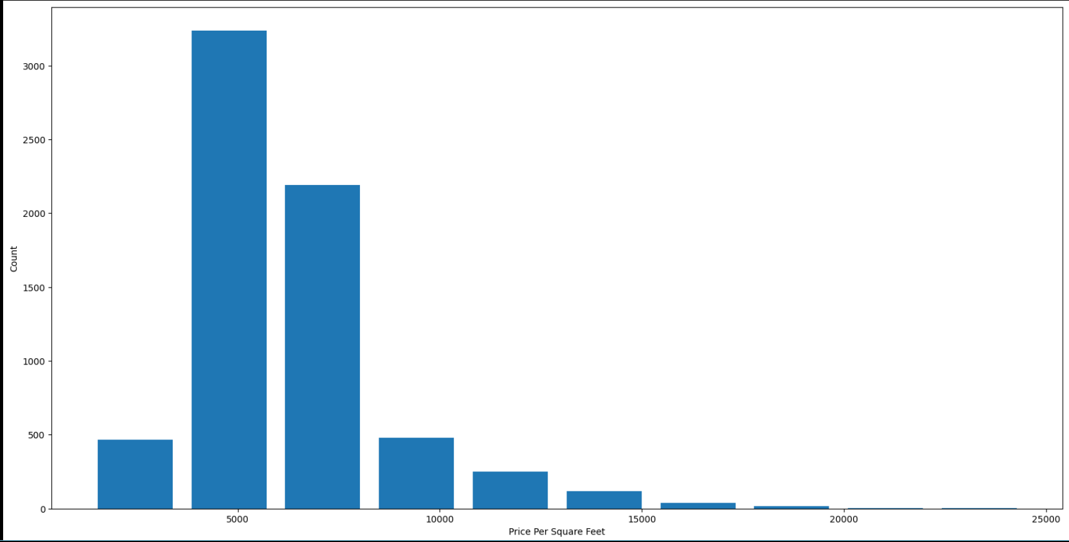
Data Exploration
Statistical and visual methods were used to understand the dataset.
Utilized dataset overview, checked null values, and used visualization techniques (box plot, scatter plot, histogram, correlation heatmap).

Slide 6
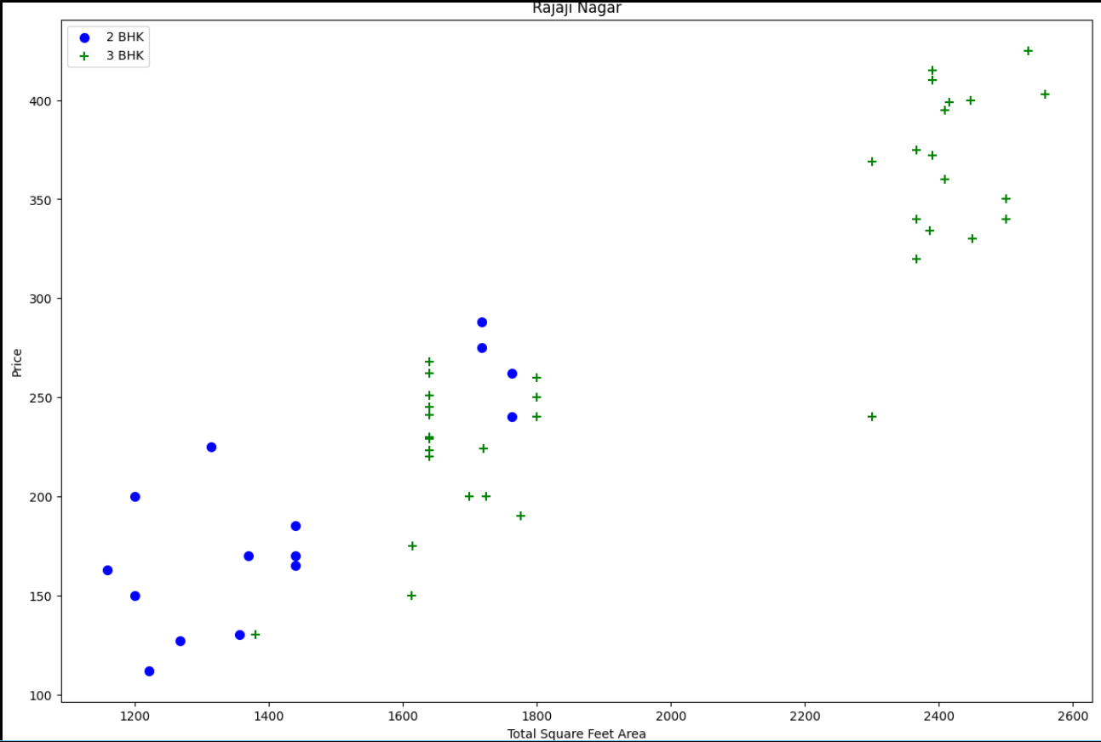
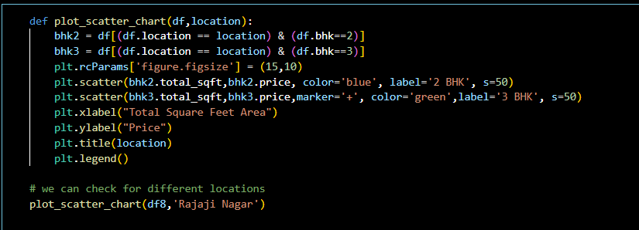
Feature Engineering
New features created, and categorical variables handled appropriately.
Data transformation techniques applied to enhance model performance.

Slide 7
Model Selection
Explored multiple models for regression and classification.
Models considered: Linear Regression, Decision Trees, Support Vector Machines, Artificial Neural Network (ANN).

Slide 8
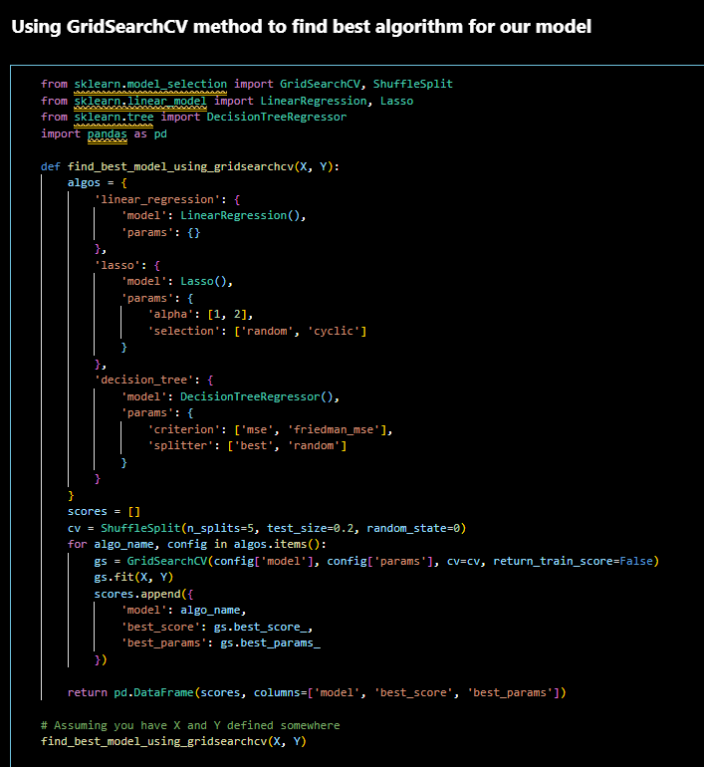
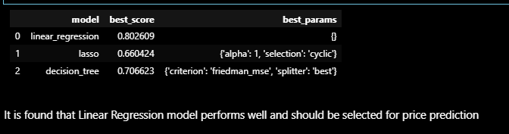
Hyperparameter Tuning
Optimized model performance through techniques like GridSearchCV.

Slide 9
Model Evaluation
Considered models: Linear Regression, Decision Trees.
Best-performing model selected for house price prediction.

Slide 10
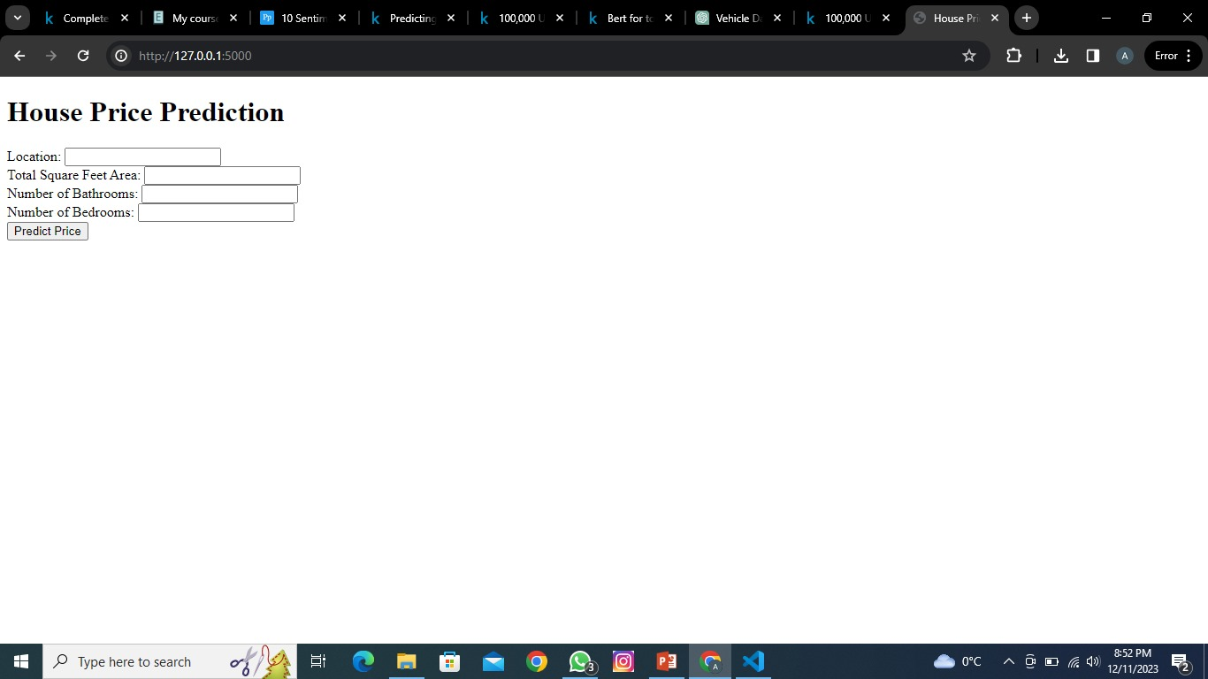
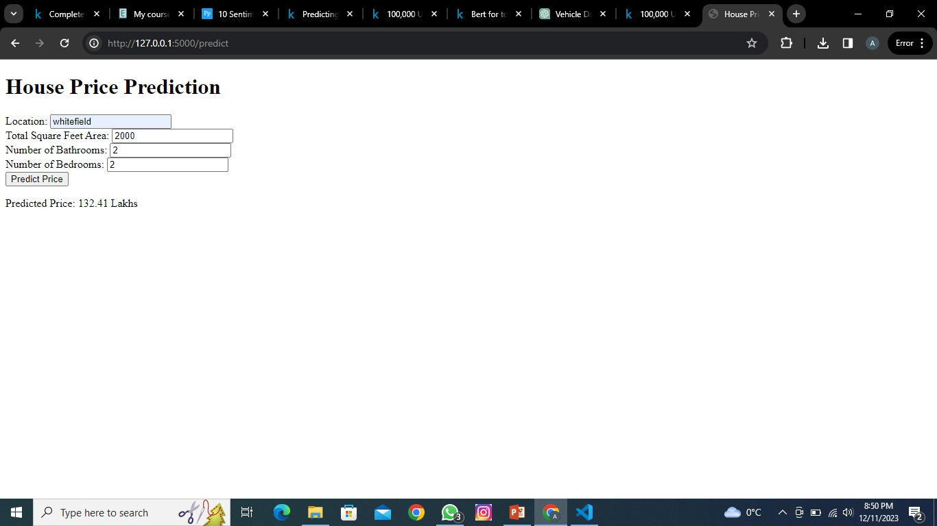
Result
Successful creation of a Flask web application for house price prediction.
Deployment on a cloud platform for accessibility.

